Slide 1
Interactive Sales Dashboard – Snitch Fashion Dataset
Prepared by: Arjun Badal Kisku
Tool: Power BI, Python
Objective: Analyze sales, profit, and quantity trends to support data-driven decisions.

Slide 2
Objective:
Design an interactive Power BI dashboard to analyze sales performance and business growth
Tools Used:
Power BI for visualization
Excel/Python for data cleaning
Dataset:Snitch_Fashion_Sales_Uncleaned.csv (Kaggle source)

Slide 3
Steps Performed:
Removed missing and duplicate records
Standardized date formats to DD-MM-YYYY
Unified city names (e.g., Hyd → Hyderabad, Bangalore → Bengaluru)
Converted numeric fields to correct data types
Saved as Snitch_Fashion_Sales_Cleaned_Final.csv

Slide 4
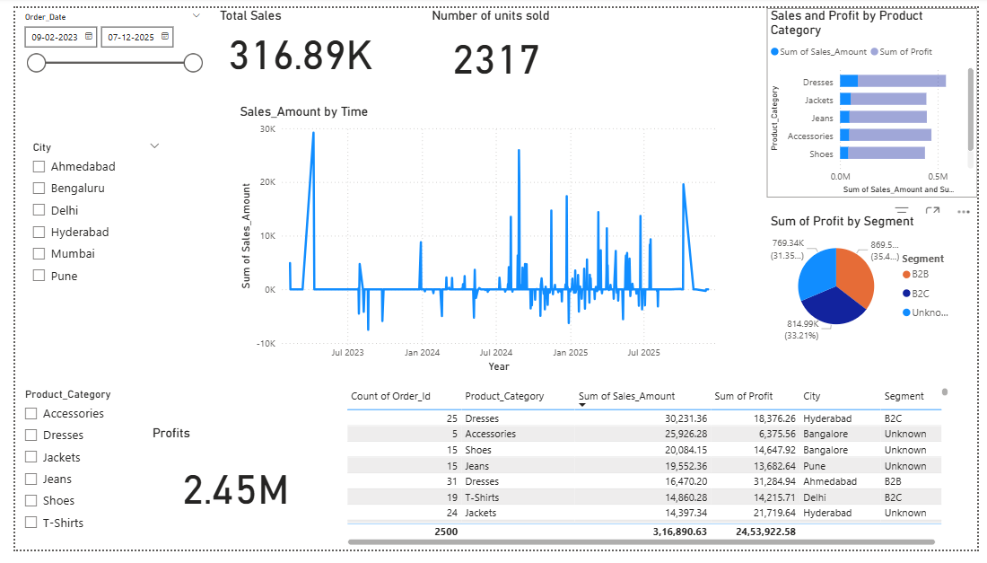
Interactive Dashboard

Slide 5
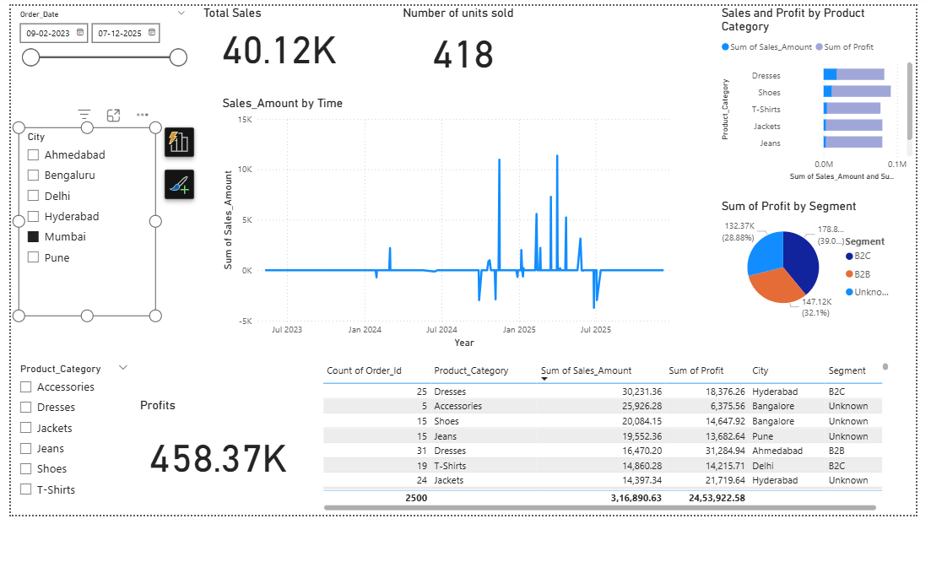
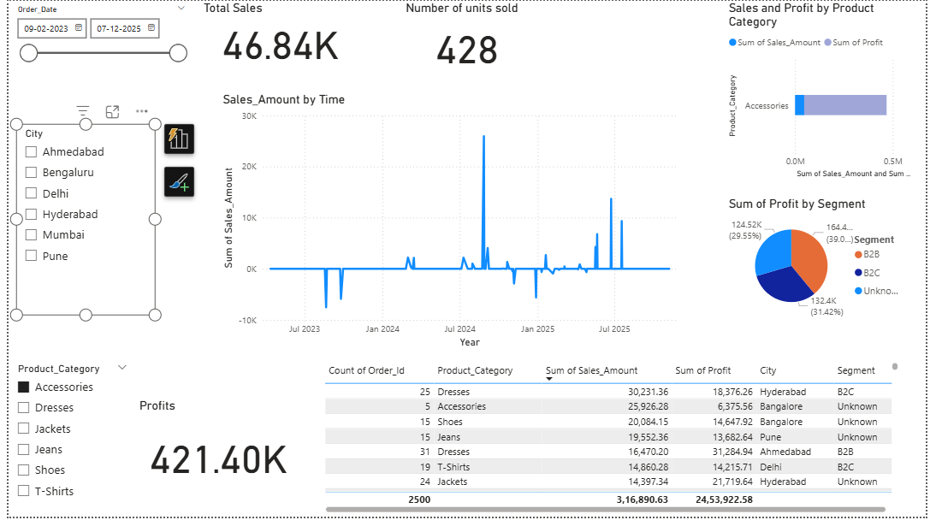
Key Observations:
Mumbai generated the maximum profit
Most revenue came from Accessories
Consistent sales growth trend over time
Opportunity: Focus marketing on underperforming cities

Slide 6
Summary:
Data cleaning → Visualization → Insights → Action
Dashboard allows quick performance monitoring
Future scope: Add forecasting and customer behaviuor analysis

